Slide 1
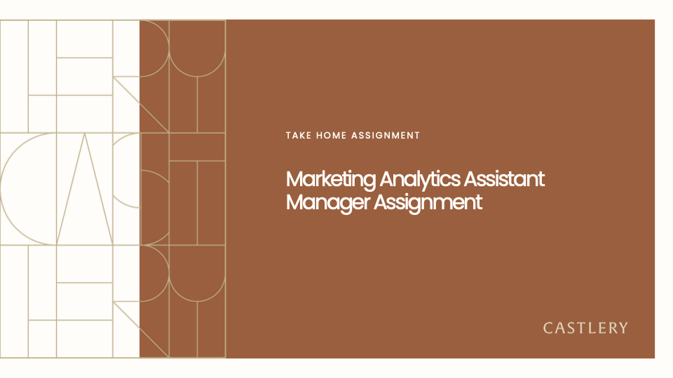
Submitted By: Farah Fatima

Slide 2
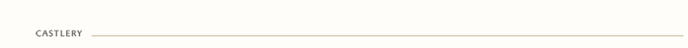
Key Problem: Castlery faces alignment challenges between its online and offline experiences, particularly in Singapore, where showroom sales contribute heavily. Significant drop-offs at critical online stages—specifically from "pageviews to 'Add to Cart'" and "checkout to purchase"—suggest potential gaps in the customer journey. Additionally, refining pricing and product positioning across channels is essential to maximize revenue and effectively target high-value items. Resolving these issues is vital to creating a seamless omnichannel strategy that resonates with customers and drives sustained growth.
Objective: To gain actionable insights that drive customer engagement, boost conversions, and increase revenue across Castlery’s online and offline channels. This analysis will focus on:
Optimizing the Customer Journey: Identify and resolve friction points across both digital and showroom touchpoints to streamline the shopping experience and improve conversion rates.
Channel-Specific Pricing Strategy: Assess how pricing affects purchasing decisions in each channel to implement targeted pricing approaches that resonate with specific customer segments.
Strategic Product and Brand Positioning: Evaluate product and brand performance in online vs. offline settings to prioritize high-performing items and tailor marketing strategies to customer preferences.
Items Covered in this solution:
Channel Performance/Comparison
Price Sensitivity Analysis
Brand Performance & Comparison across Channels
Customer Journey/Conversion Funnel
Strategies/Recommendation
Additional Analytical Project Idea
Appendix

Slide 3
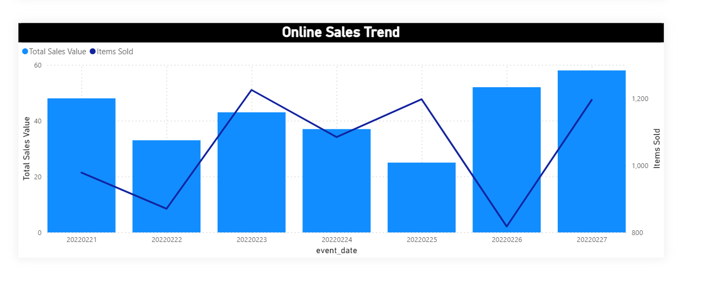
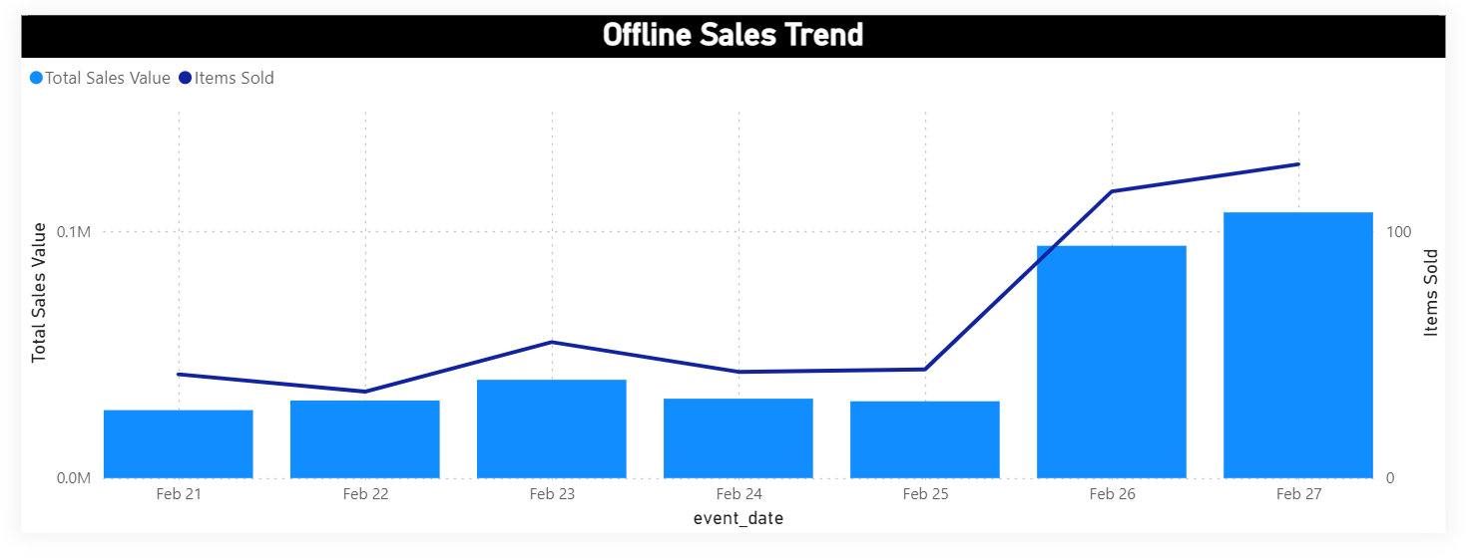
Channel Comparison:
Metric | Online Channel | Offline Channel
Average Transaction Value | $1,145 | $1,626
Total Sales Value | $180,902 | $365,954
Total Items Sold | 296 | 462
Average Items per Purchase | 1.87 | 2.05
Daily Performance:
Offline: Highest Daily Quantity Purchased: 127 items on February 27, 2022 (Sunday)
Average Weekly Purchases: 218 orders
Average Weekly Items Sold: 462 items
Highest Daily Revenue: $107,901.20 on February 27, 2022
Most Active Date (Foot Traffic): February 20, 2022 (Thursday) with 144 foot traffic
Online: Highest daily quantity purchased: 58 on 2022-02-27 (Sunday)
Average weekly purchases: 158 orders
Average weekly items: 296 items
Highest daily revenue: $41,536.43 on 2022-02-27

Slide 4
2. Price Sensitivity Analysis
ONLINE:
Average Price: $611.16
Optimal Price Points:
$1,000 - $1,500: Highest revenue generator with $73,036.43; strong demand for premium items, appeals to high-spending customer segment.
Number of items sold in this price threshold: 61
OFFLINE:
Average Price: $798.92
Optimal Price Points: Higher revenue observed at price points above $1,250
Total Revenue from items priced above $1,250: $121,325.79
Number of items sold above this price threshold: 70
Revenue Distribution across Price Buckets:
$1,000 - $1,500: Highest revenue at $73,036.43, indicating strong demand for premium-priced items.
$800 - $900: Significant revenue of $27,875.79, appealing to high-spending customers.
$400 - $500: Moderate pricing sweet spot, generating $16,301.89.
$1,500 - $2,000: High-end demand with $13,291.60 in revenue.
Revenue Distribution across Price Buckets:
$0 - $500: Total revenue of $36,799.09, average price around $241.92.
$500 - $1000: Total revenue of $131,724.25, average price around $784.07.
$1000 - $1500: Total revenue of $111,552.91, average price around $1199.49.
$1500 - $2000: Total revenue of $55,108.93, average price around $1722.15.
$2000 - $2500: Total revenue of $18,384.73, average price around $2298.09.

Slide 5
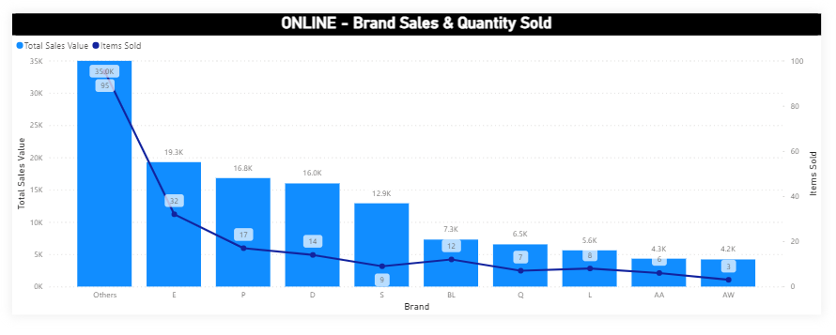
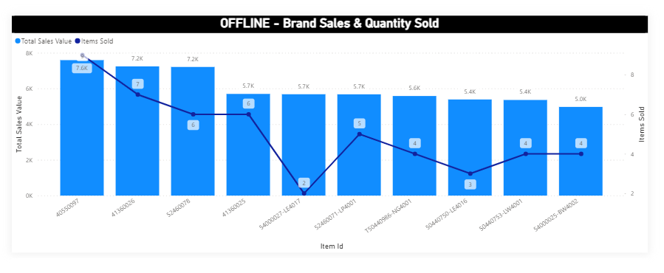
3. Brand Performance & Comparison across Channels:
The brand "Others" has the highest total sales at approximately 34,966 and the largest number of items sold (95 units), indicating a wide variety of brands or items under this category.
Brands E, P, and D also have significant sales, though their quantities sold are lower compared to "Others." This could suggest higher individual item prices or specific consumer demand for these brands online.
Items like 40550097, 41360026, and 52460078 are among the highest earners in offline sales, with revenues around 7,000 units each.
The quantities sold per item are relatively low, suggesting high-priced items or products with lower volume sales.
Top Brands by Market Share - OFFLINE:
Item 40550097: $7,591.74 revenue, 9 units sold (Market Share: 2.08%)
Item 41360026: $7,240.41 revenue, 7 units sold (Market Share: 1.99%)
Item 52460078: $7,209.27 revenue, 6 units sold (Market Share: 1.98%)
Item 41360025: $6,635.61 revenue, 7 units sold (Market Share: 1.81%)
Item 54000027-LE4017: $5,679.58 revenue, 2 units sold (Market Share: 1.56%)
Top Brands by Market Share - ONLINE:
Brand "Others": $44,499.11 revenue, 95 units sold (Market Share: 24.60%)
Brand E: $20,577.58 revenue, 32 units sold (Market Share: 11.37%)
Brand P: $17,180.38 revenue, 17 units sold (Market Share: 9.50%)
Brand D: $15,977.56 revenue, 14 units sold (Market Share: 8.83%)
Brand S: $12,898.13 revenue, 9 units sold (Market Share: 7.13%)

Slide 6
3. Brand Performance & Comparison across Channels:
Most Purchased Products:
Top performer: Item 52460052 (Others brand) with 7 purchases, avg price $428.97
Second: Multiple items (53900003, 40370057, 40550097) tied with 5 purchases each
Price range varies significantly ($36.45 to $1,120.56)
Most abandoned products(Left in Cart):
PB-LR0154 (AM brand): 1,271 abandonments, avg price $1,072.90
PB-DR0122 (AX brand): 951 abandonments, avg price $1,728.04
PB-LR0060 (F brand): 599 abandonments, avg price $1,017.76
Comparative Insights
Higher Total Sales in Offline: Offline sales revenue is more than double the online sales, showing a stronger offline presence or larger customer base for in-store purchases.
Higher Brand Loyalty Online: The average sale per brand online is significantly higher than per item offline, indicating that online customers may be more brand-specific in their purchases.
Quantity Patterns: Although offline sales have higher individual purchases, online customers tend to buy more per transaction, possibly due to the convenience or specific promotional incentives offered online.

Slide 7
4. Online Customer Journey
Stage | Absolute Number | Conversion % from Previous Stage
Pageviews | 754,847 | -
Add to Cart | 19,063 | 2.52%
Begin Checkout | 1,177 | 6.17%
Purchases | 161 | 13.68%
Conversion Funnel Analysis:
Add to Cart Rate: 40.13% of users add items to cart
Checkout Rate: 6.17% of cart additions proceed to checkout
Purchase Rate: 13.68% of checkouts convert to purchase
Key Insights:
Significant Drop-offs: Major drop-off from Pageviews to Add to Cart, and another from Checkout to Purchase, indicating areas for improvement in user experience.
Funnel Visualization: Conversion rates from Pageviews to Purchases, highlighting drop-off points at each stage for targeted interventions.
Drop-off Causes: Possible reasons may include:
High Shipping Costs
Price Sensitivity
Limited Payment Options

Slide 8
5. Recommendations
Marketing Strategy to Bridge Online and Offline Behavior
Showrooming Strategy:
Use QR codes on showroom product displays that link to detailed online product pages, where customers can view additional images, specifications, and customer reviews and complete purchase with promotional discounts that are only available online. This will connect offline visits with online conversions.
Offer showroom-exclusive QR code discounts redeemable online to encourage users to transition their journey from offline to online. For instance, a 15% discount if the item is purchased within 24 hours of showroom interaction.
Reverse Showrooming (Webrooming):
Allow customers to initiate their journey online by browsing products and completing purchases in-store with dedicated sales assistance. Create a seamless “Save and View In-Store” option on online product pages, allowing customers to create a list of items to see in person at the nearest showroom. Send notifications or updates when a customer is near a specific location. Offer price matches or in-store promotions for online items to incentivize showroom purchases.
. Targeted Price Sensitivity Campaigns
Dynamic Pricing Tiers:
Tactic: Focus on high-revenue price segments like $1,000–$1,500 for online premium items. Offer options like interest-free installments or bundle discounts (e.g., a coffee table with a matching sofa) to make premium items more accessible.
Implementation: Use online and in-store banners and email marketing to promote financing options and bundle discounts for high-revenue items in target price ranges.
Segment-Specific Promotions:
Tactic: Use customer segmentation based on past purchasing behaviors (e.g., premium spenders vs. budget-conscious buyers) and target them with price-sensitive promotions.
Implementation: For high spenders, send personalized messages offering exclusive early access to high-ticket items or flash sales in the $1,000+ range. For budget-conscious buyers, promote discounts on mid-tier items to encourage upselling.

Slide 9
5. Recommendations
Personalized Marketing and Retargeting
Cross-Channel Cart Recovery:
Create personalized email and SMS retargeting campaigns for users who abandon their cart. Offer showroom consultations or online discount codes to complete the purchase.
Design retargeting emails with dynamic content reflecting the specific items left in the cart and their availability in-store. Include call-to-action buttons like “Complete Purchase Online” or “See Item In-Store,” depending on the customer’s browsing patterns.
Behavior-Driven Campaigns:
Target customers who view high-ticket items (e.g., $1,000+) multiple times without purchasing, sending them personalized retargeting messages encouraging them to complete their purchase or book a showroom appointment.
Use data on time spent and number of visits to high-ticket product pages to identify likely buyers. Trigger customized ads or emails offering online-only perks or appointment booking for showroom viewing.
Unified Omnichannel Experience
Omnichannel Cart Access:
Enable customers to start a shopping cart online and finalize the purchase offline, or vice versa, by implementing a unified cart system.
Integrate Castlery’s online platform with in-store POS systems so customers can view and modify their cart across both environments. Include features like digital cart QR codes that customers can scan in-store to continue their online cart in the showroom.
Integrated Loyalty Program:
Introduce a points-based loyalty program that rewards customers for purchases across online and offline channels. Points can be redeemed for discounts, exclusive products, or VIP access to sales.
Assign points for each purchase made, with multipliers for purchases in high-revenue categories or referrals. Create loyalty tiers with increasing benefits, e.g., Silver (early access), Gold (VIP events), and Platinum (personal shopper).

Slide 10
5. Recommendations
Conversion Funnel Optimization Focused on Cross-Channel Insights
Unified Cart and Checkout Experience:
Enable customers to start a cart online and complete the purchase offline, or vice versa. This unification can improve conversion rates by reducing the friction caused by customers switching channels.
Cross-Channel Cart Recovery Campaigns:
Develop email and SMS campaigns specifically for users who abandon their carts across different channels. For instance, if someone adds items to their cart online but doesn’t purchase, offer showroom-based assistance or promotions.
Enhanced Customer Journey Experience
Streamlined Checkout:
Reduce the number of steps in the online checkout process and optimize in-store checkout flow by training staff to assist customers with digital checkout options.
Offer a guest checkout option, minimize required fields, and integrate multiple payment options to reduce friction. In-store, equip staff with tablets to assist with on-the-spot checkouts for high-traffic periods.
User-Generated Content and Reviews:
Improve trust on product pages by featuring customer reviews, user photos, and visual content from social media.
Encourage customers to submit reviews and photos post-purchase by offering incentives like loyalty points or discounts. Highlight these reviews on relevant product pages, especially for high-consideration items.

Slide 11
6. Additional Analytical Project Idea
Project Idea: Intelligent Upsell & Cross-Sell Engine
Objective: Boost revenue by maximizing each customer’s purchase value through tailored product recommendations.
Key Components:
Curated Bundles: Use purchase data to create product bundles (e.g., sofas with matching coffee tables), increasing average order size.
In-Cart Upsells: During checkout, suggest premium or complementary items that enhance items already in the cart, encouraging upgrades and add-ons.
Exclusive Offers for Repeat Customers: Reward high-value customers with early access to collections and tailored discounts on products that match their style.
Seasonal Recommendations: Offer timely suggestions based on seasonal needs (e.g., outdoor furniture for summer), driving timely, relevant purchases.
Why It Matters: This targeted approach drives higher revenue per transaction, turning every purchase into an opportunity for growth. It’s a cost-effective strategy that leverages existing data to enhance customer experience and loyalty, positioning Castlery as the go-to brand for cohesive, stylish home solutions.

Slide 12
6. Appendix:
Process I undertook: Offline: MarketingAnalyticsAsstManager_Assignment_Data had all offline purchase data that I transformed to see All items, their prices and quantities separately for each user
Online: web_events_item_brand had data for all events, I transformed the data by placing purchase events separately and covering transformations to see All items, their prices and quantities separately for each user
All Offline Code: Offline Data Analysis.ipynb All Online Code: Online Data Analysis.ipynb

